Slide 1

Pricing Analytics
BY TEAM 3

Slide 2
App 1

Slide 3
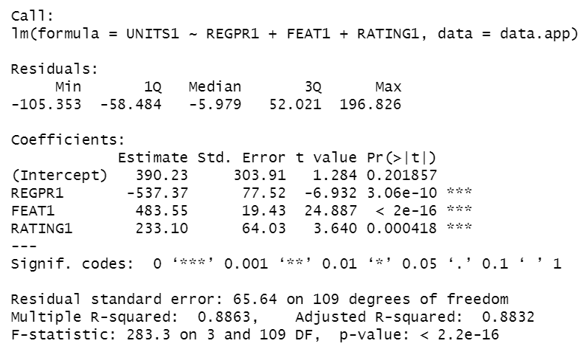
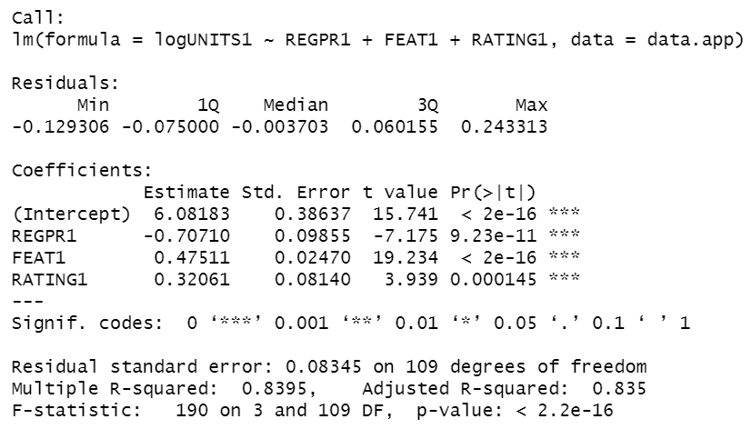
App 1 – Own effects, incorporating price, feature and rating
Linear Model
Better model
Semi-Log Model
High R Square of 0.89
All independent variables are significant
Slightly lower R Square of 0.84
All independent variables are significant

Slide 4
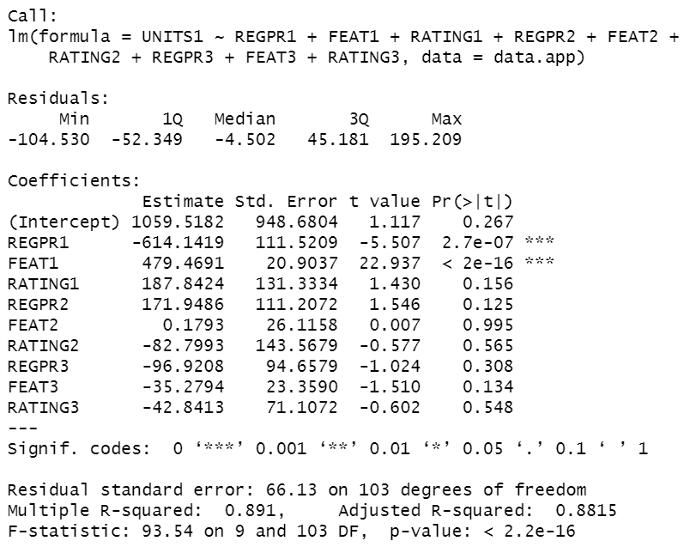
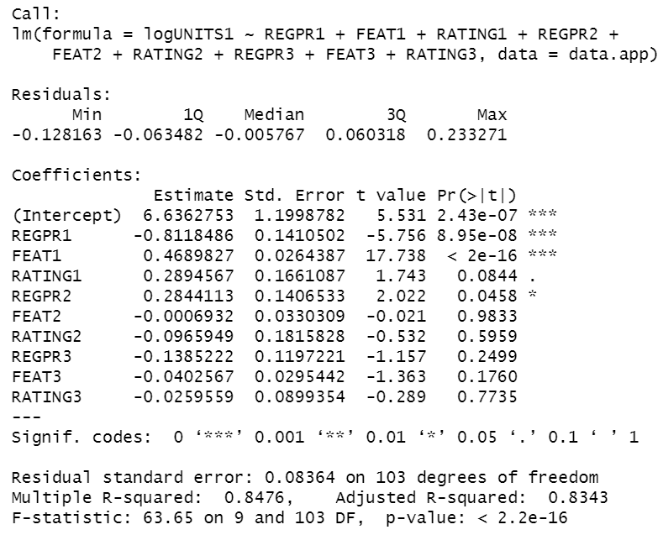
App 1 – Own effects and competitive effects
Linear Model
Better model
Semi-Log Model
High R Square of 0.89, slight improvement from the linear model with own effects only
Competitors’ prices and promotions are insignificant
Slightly lower R Square of 0.85
Most competitors’ prices and promotions have insignificant impact

Slide 5
App 1 – Best model
Linear Model incorporating own effects only
Rationale for choosing this model
More simple and robust than other models
Requires less data, which will be useful as competitors’ data is not always available
High R Squared of 0.89
Compared to linear model with competitive effects, the linear model with own effects only has a lower standard error
Adjusted R Squared is high and close to R Squared
Only significant predictors are included
Interpretation of the model
Without competitive effect, App 1’s price has a statistically significant impact on its sales, with 1% increase in price leading to 0.72% decrease in sales (price elasticity is -0.72)
Feature also has impact on sales. If app 1 is featured, sales will increase by 0.58% (feature elasticity is 0.58)
Rating is also a significant predictor of sales

Slide 6
App 2

Slide 7
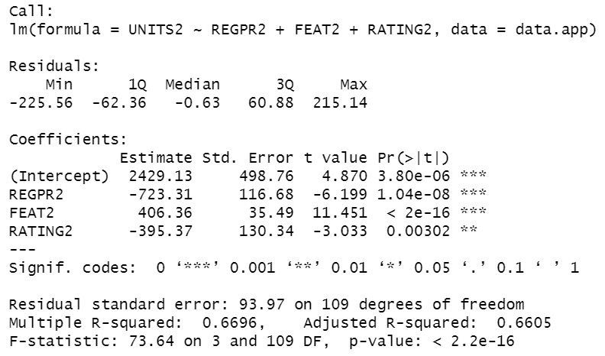
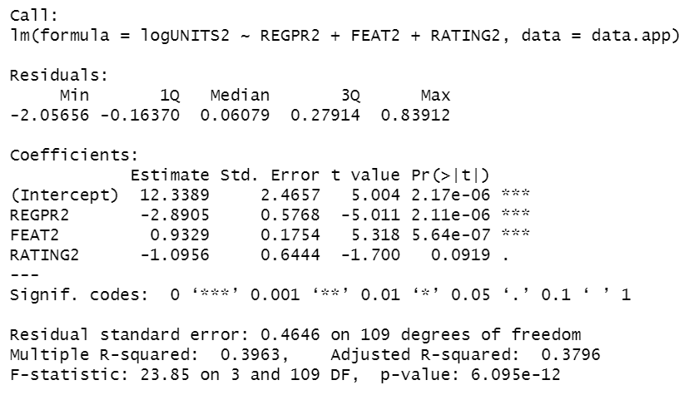
App 2 – Own effects, incorporating price, feature and rating
Linear Model
Better model
Semi-Log Model
Moderate R Square of 0.67
All independent variables are significant
Significantly lower R Square of 0.4
Rating is only significant at 10% significance level

Slide 8
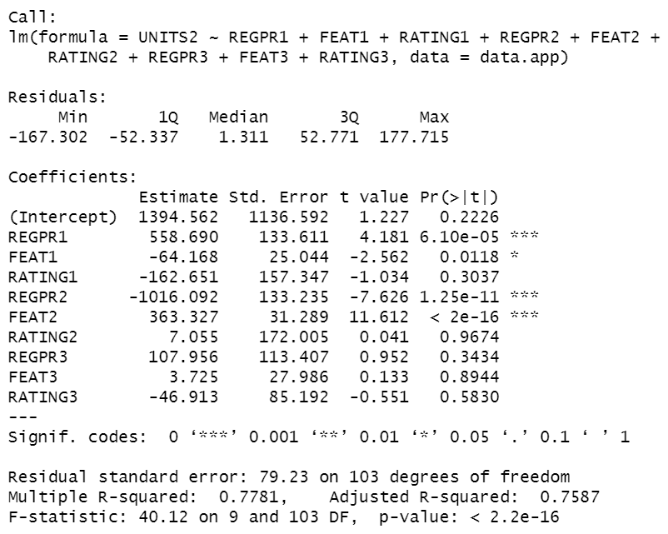
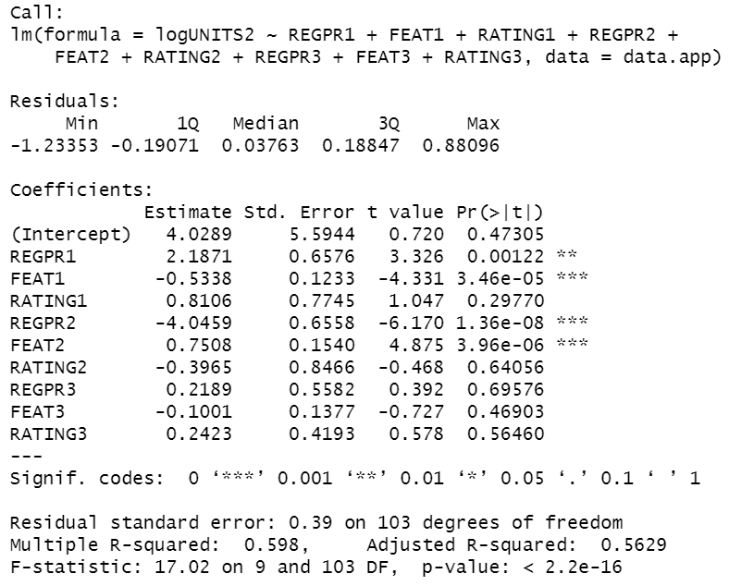
App 2 – Own effects and competitive effects
Linear Model
Better model
Semi-Log Model
High R Square of 0.78, large improvement from the linear model with own effects only (0.67)
App 1’s price and feature have significant impact on app 2’s sales
App 2’s own rating becomes insignificant
Significantly lower R Square of 0.6
App 1’s price and feature are also significant
App 2’s own rating becomes insignificant

Slide 9
App 2 – Best model
Linear Model incorporating own effects and competitive effects
Rationale for choosing this model
R Squared of the linear model with competitive effects has been significantly improved from the linear model with only own effects
The stand error of linear model with competitive effects is lower than the linear model with own effects only
Compared to the semi-log model, this model is more simple and has better fit (higher R Squared of 0.78 compared to 0.59)
Another option is to remove all the insignificant predictors, which could result in an improved adjusted R square
Interpretation of the model
App 2’s price has a significant impact on its sales, with 1% increase in price leading to a decrease of 3.66% in sales (app 2’s price elasticity is -3.66)
Feature also has a large impact. If app 2 is featured, sales will increase by 1.30% (feature elasticity is 1.30)
App 1’s price affects app 2’s sales, with 1% increase in app 1’s price leading to 2.23% increase in app 2’s sales (app 1’s price elasticity is 2.23)

Slide 10
App 3

Slide 11
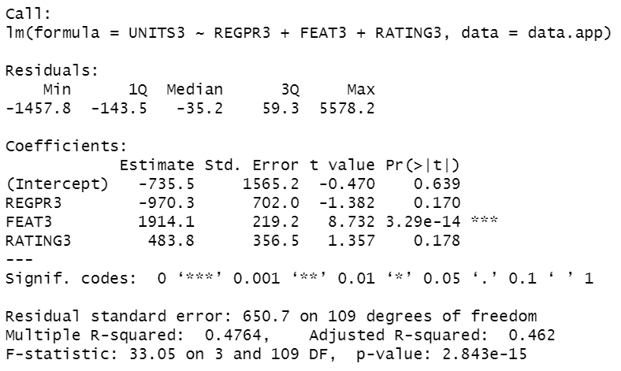
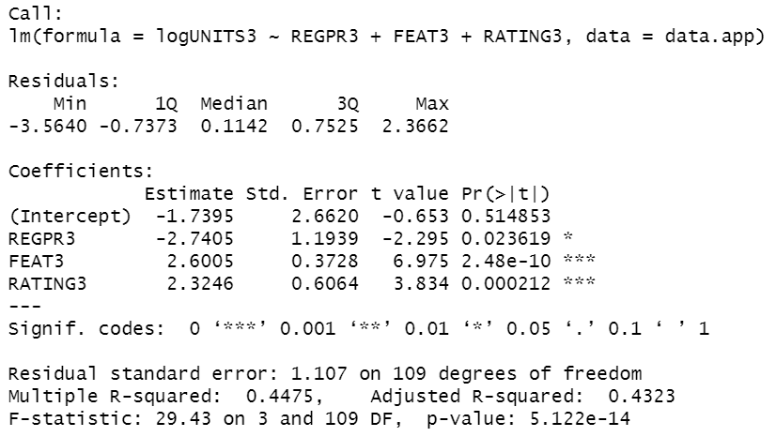
App 3 – Own effects, incorporating price, feature and rating
Linear Model
Better model
Semi-Log Model
Decent R Square of 0.48
Only feature is significant but price and rating are insignificant
Slightly lower R Square of 0.45
All independent variables are significant

Slide 12
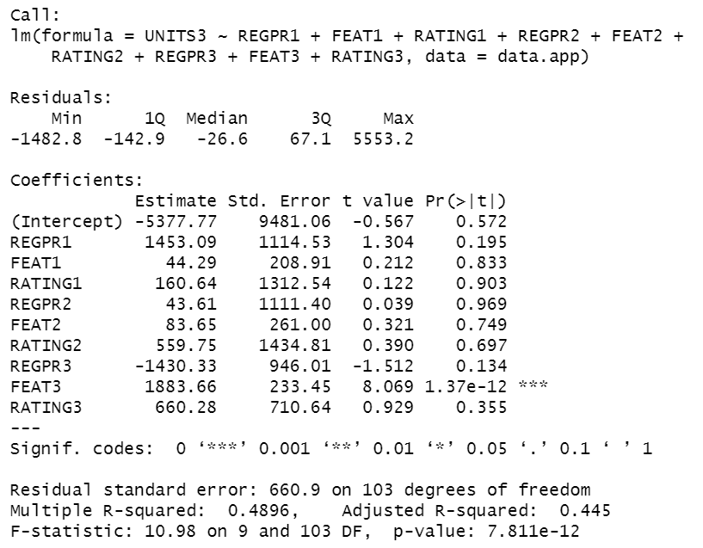
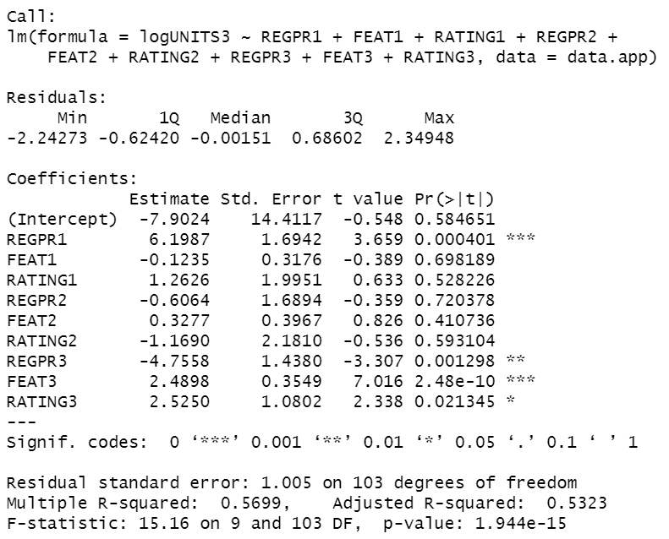
App 3 – Own effects and competitive effects
Linear Model
Semi-Log Model
Better model
Slight improvement from the linear model with own effects only (from 0.48 to 0.49)
Only app 3’s feature has significant impact on app 3’s sales
Good improvement from the linear model with R Square of 0.57
App 3’s price, feature, and rating as well as app 1’s price have significant impact on app 3’s sales

Slide 13
App 3 – Best model
Semi-Log Model incorporating own effects and competitive effects
Rationale for choosing this model
R Squared of the semi-log model with competitive effects is the highest among all models (0.57)
The stand error of semi-log model with competitive effects is lower than the semi-log model with own effects only
Another option is to remove all the insignificant predictors, which could result in an improved adjusted R square
Interpretation of the model
App 3’s price has a large impact on app 3’s sales. For every 1% increase in price, app 3’s sales decrease by 4.58% (app 3’s price elasticity is - 4.58)
Interestingly, app 1’s price has a larger impact on app 3’s sales than app 3’s price, indicating that app 1 is a strong competitor. For every 1% increase in app 1’s price, app 3’s sales increase by 6.92% (app 1’s price elasticity is 6.92)
If app 3 is featured, its sales will increase by 2.49% (feature elasticity is 2.49)

Slide 14
Summary of Best Models
App 1 | App 2 | App 3
Linear Model incorporating own effects only | Linear Model incorporating own effects and competitive effects | Semi-Log Model incorporating own effects and competitive effects
R-Square value = 0.89 | R-Square value = 0.78 | R-Square value = 0.57

Slide 15
Clout and vulnerability map

Slide 16
Clout and vulnerability map
Model | App | Estimated significant price coefficients
 |  | App 1 | App 2 | App 3
Linear Model incorporating own effects and competitive effects | App 1 | -614.142
Linear Model incorporating own effects and competitive effects | App 2 | 558.690 | -1016.092
Semi-Log Model incorporating own effects and competitive effects | App 3 | 6.199 |  | -4.756
Model | App | Estimated price elasticities (significant only)
 |  | App 1 | App 2 | App 3
Linear Model incorporating own effects and competitive effects | App 1 | -0.827
Linear Model incorporating own effects and competitive effects | App 2 | 2.232 | -3.656
Semi-Log Model incorporating own effects and competitive effects | App 3 | 6.924 |  | -4.579

Slide 17
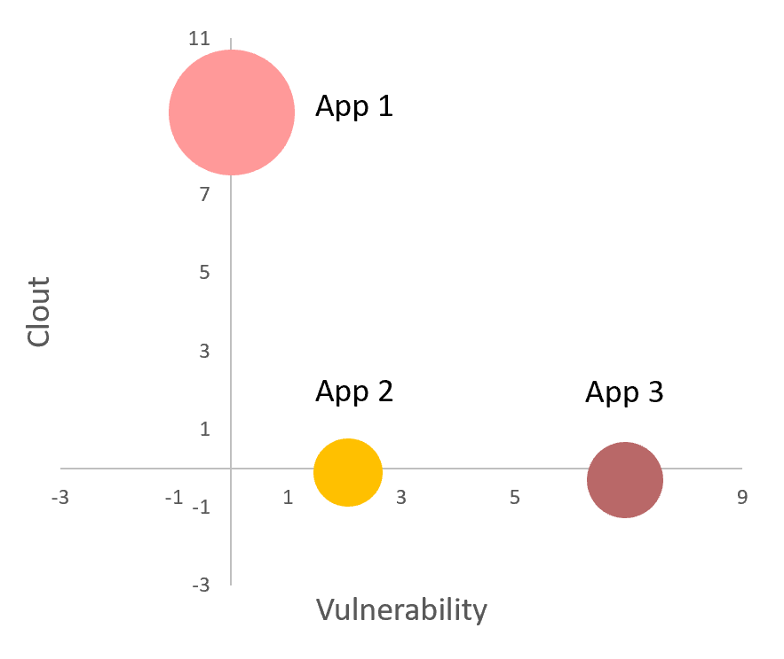
Clout and vulnerability map
App | Clout | Vulnerability | Revenue share
App 1 | 9.154 | 0.000 | 60%
App 2 | 0.000 | 2.23 | 18%
App 3 | 0.000 | 6.924 | 22%

Slide 18
Interpretation of clout and vulnerability map
Assumption: We only consider a segment of the market with three players as provided in the dataset
As a market leader (60% market share), app 1 is the strongest player among the three apps, with the highest clout value of 9.154 . The other two apps’ prices do not have significant impact on its sales
Meanwhile, app 1’s price affects both app 2’s sales and app 3’s sales - app 2 and app 3 are both vulnerable to app 1’s pricing changes
App 2 and app 3 have similar market shares, however, app 3 is the most vulnerable to app 1’s prices. The impact of app 1’s price on app 3’s sales is larger than its own price

